Slide 1
CSP571 Data Preparation and Analysis
Lecture 5. Logistic Regression. Gradient Descent. Data Vizualization
Oleksandr Narykov
onarykov@iit.edu

Slide 2
Logistic Regression

Slide 3
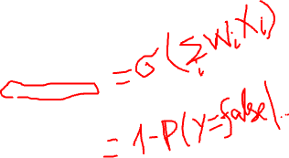
Logistic Regression
Learns 𝑃(𝑌|𝑿) directly, without going through
𝑃(𝑿|𝑌) and 𝑃(𝑌)
Assumes 𝑃(𝑌|𝑿) follows the logistic function
1
𝑃 𝑌 = 𝑓𝑎𝑙𝑠𝑒
𝑋₁, 𝑋₂, ⋯ , 𝑋_{𝑛}) =
𝑛
1 + 𝑒
𝑤 +∑
𝑤_{𝑖}𝑋_{𝑖}
0
𝑖=1
𝑒
𝑤 + ∑
𝑛
𝑖=1
𝑤_{𝑖}𝑋_{𝑖}
𝑃 𝑌 = 𝑡𝑟𝑢𝑒
𝑋₁, 𝑋₂, ⋯ , 𝑋_{𝑛}) =
0
1 + 𝑒
𝑤 + ∑
𝑛
𝑤_{𝑖}𝑋_{𝑖}
0
𝑖=1
Learning: estimate the weights 𝑤₀, 𝑤₁, … , 𝑤_{𝑛}

Slide 4
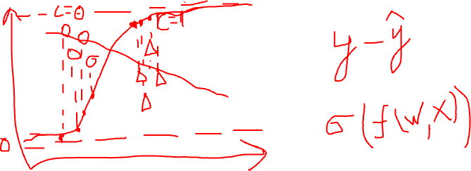
Logistic Regression

Slide 5
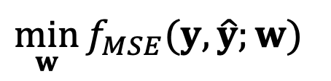
Optimization Problem
$$\min_{w}{f_{MSE}(y,\hat{y};w)}$$
10

Slide 6
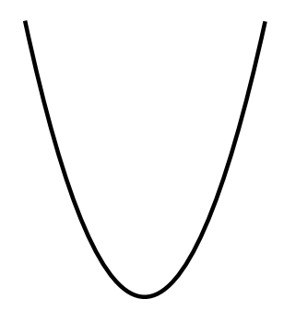
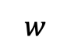
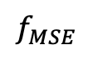
Optimization Problem
$$\min_{w}{f_{MSE}(y,\hat{y};w)}$$
Simple 1d Case – Convex Function
$$f_{MSE}$$
f
10
$$w$$

Slide 7
Convexity
Informally: bowl-shaped
f
10
Notes:
Inverse is concave

Slide 8
Convexity
Informally: bowl-shaped
f
What property ensures the existence of only one local minimum?
10

Slide 9
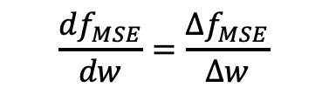
Convexity
Informally: bowl-shaped
f
$$\frac{df_{MSE}}{dw}=\frac{∆f_{MSE}}{∆w}$$
What property ensures the existence of only one local minimum?
From left to right, the slope of function never decreases
Derivative of the slope is always non-negative
10

Slide 10
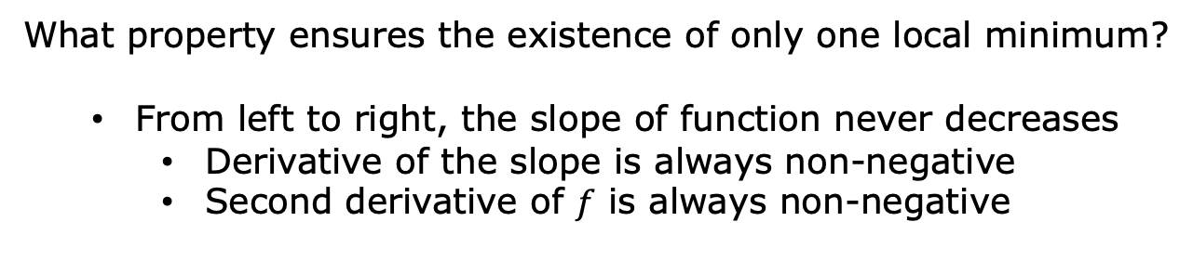
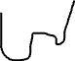
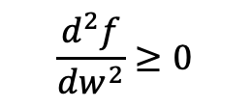

Convexity
Informally: bowl-shaped
f
$$\frac{df}{dw}=\frac{∆f}{∆w}$$
$$\frac{d^{2}f}{dw^{2}}≥0$$
What property ensures the existence of only one local minimum?
From left to right, the slope of function never decreases
Derivative of the slope is always non-negative
Second derivative of $f$ is always non-negative
10

Slide 11
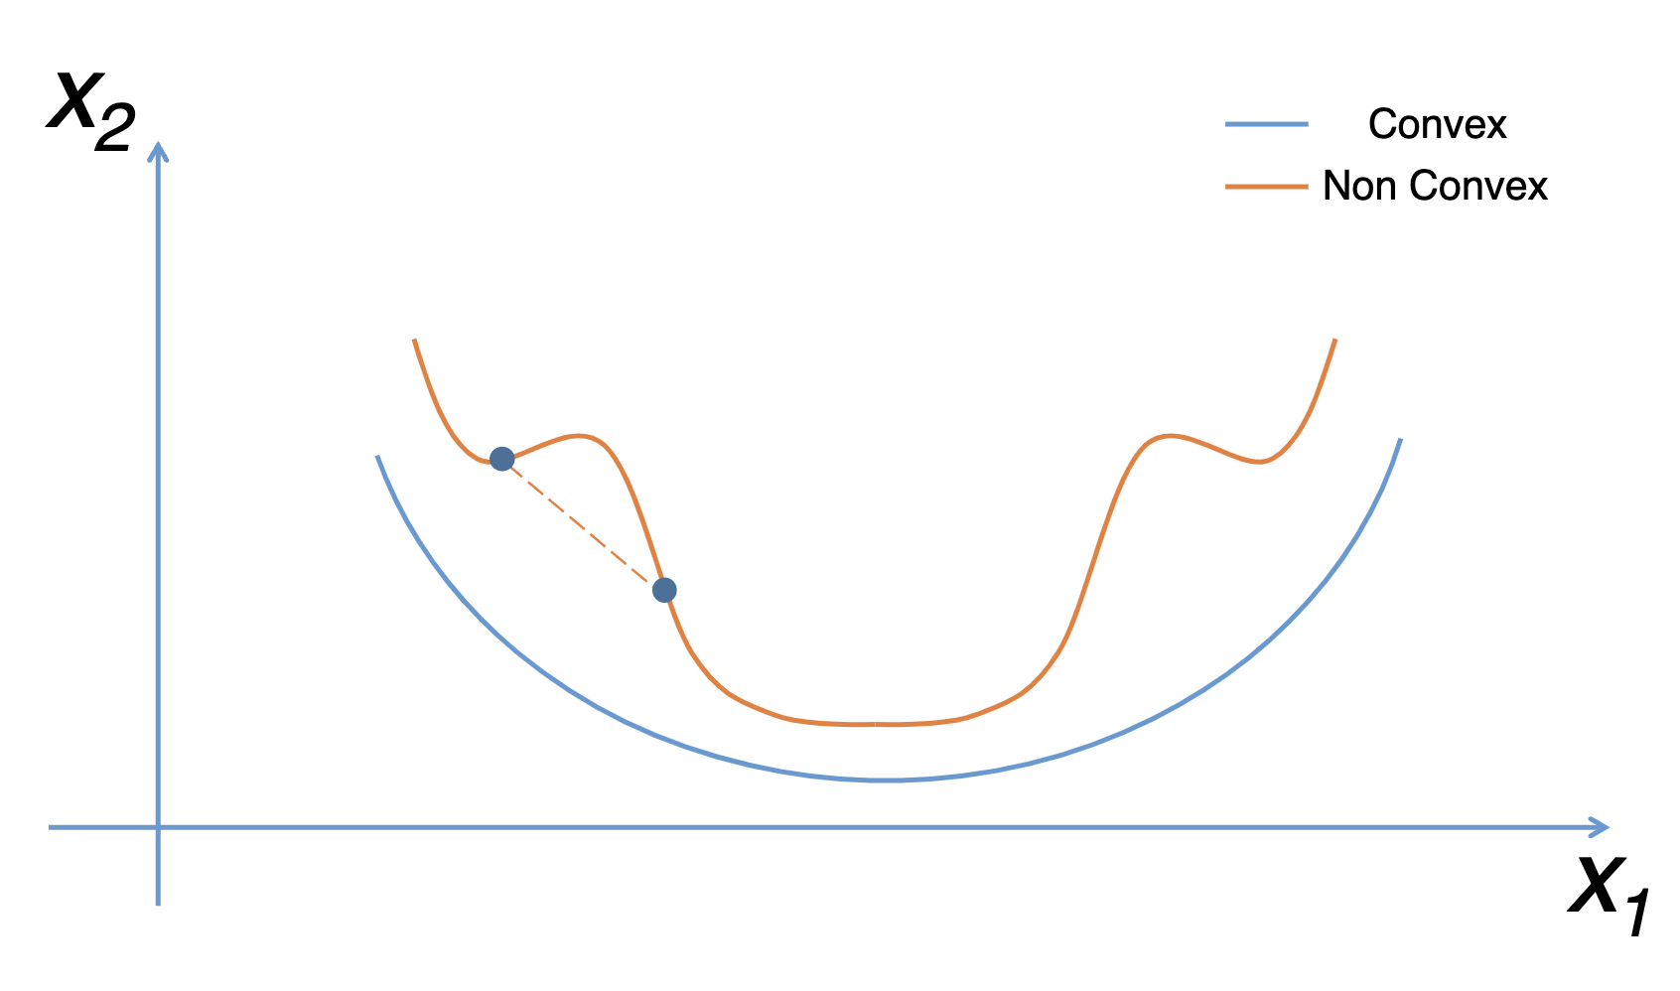
Convexity
https://fmin.xyz/docs/theory/Convex_function/
What property ensures the existence of only one local minimum?
From left to right, the slope of function never decreases
Derivative of the slope is always non-negative
Second derivative of $f$ is always non-negative
10

Slide 12
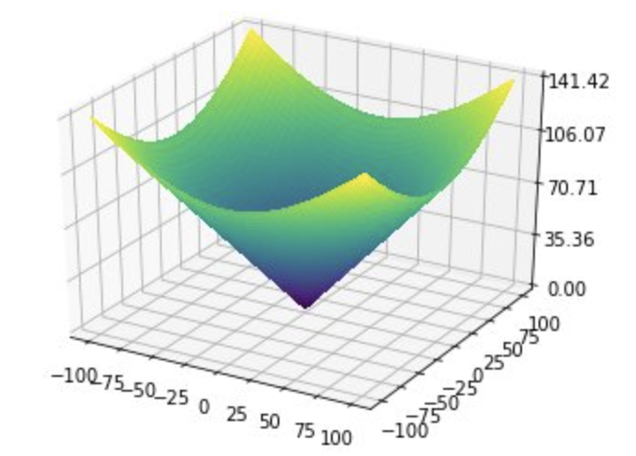
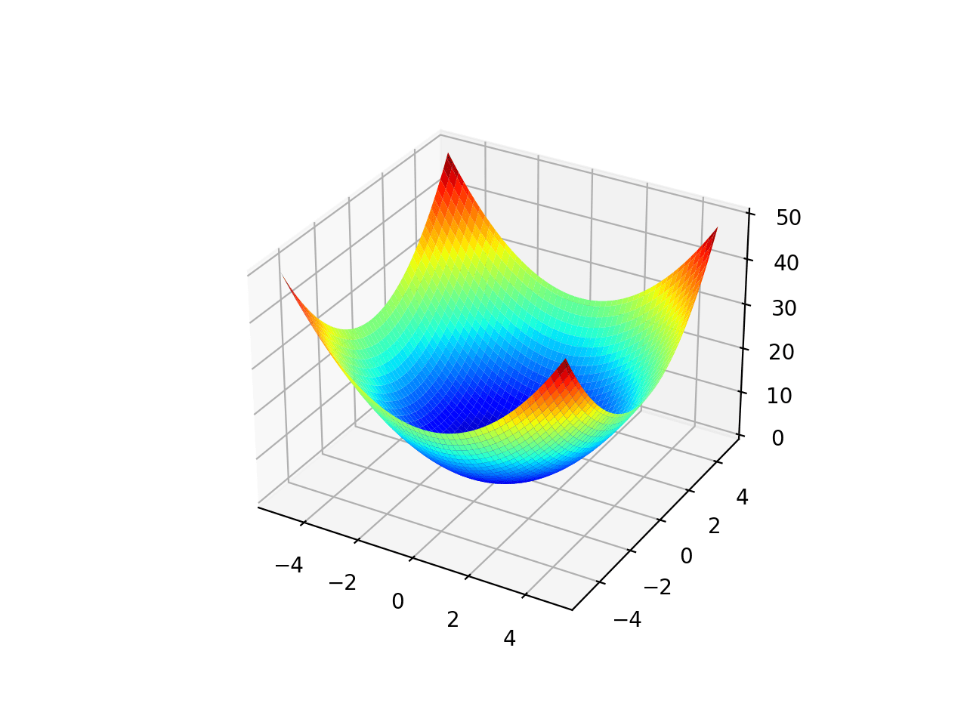
Convexity in Higher Dimensions
Informally: bowl-shaped
Benhamou, Eric, et al. "BCMA-ES: A Bayesian approach to CMA-ES." arXiv preprint arXiv:1904.01401 (2019).
https://machinelearningmastery.com/wp-content/uploads/2020/09/Surface-Plot-of-Unimodal-Optimization-Function-1.png
10

Slide 13
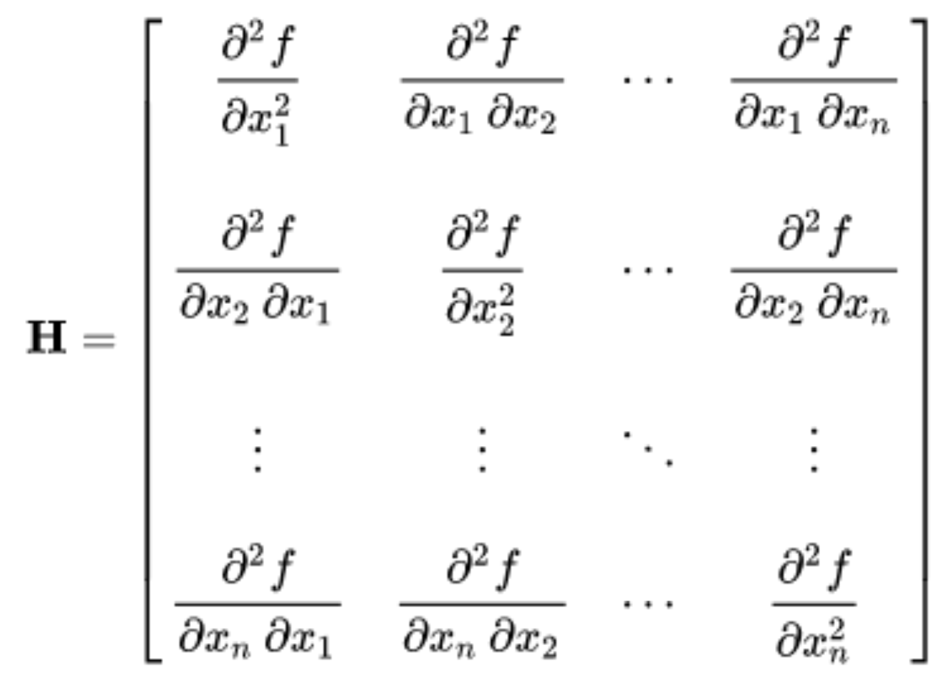
Convexity in Higher Dimensions
Informally: bowl-shaped
Formally: determined by the second-derivative matrix, Hessian
10

Slide 14
Convexity in Higher Dimensions
Informally: bowl-shaped
Formally: determined by the second-derivative matrix, Hessian
For function to be convex, Hessian matrix H should be positive
semi-definite (PSD) for every input x
10

Slide 15
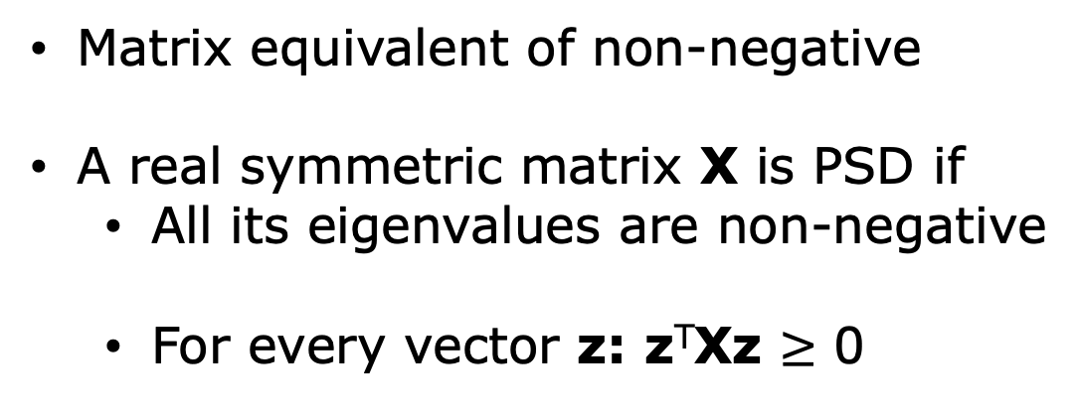
Positive Semi-Definite
Matrix equivalent of non-negative
A real symmetric matrix X is PSD if
All its eigenvalues are non-negative
For every vector z: z^{T}Xz $≥$ 0
10

Slide 16
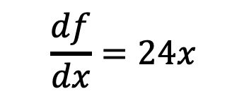
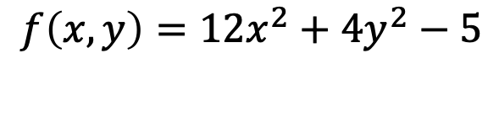
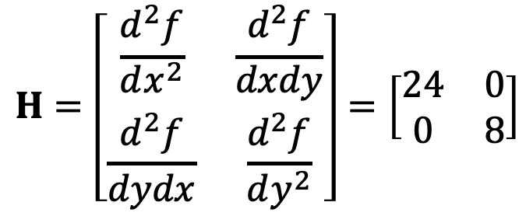
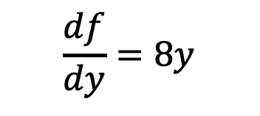
Hessian Example
$$f\left(x,y\right)=12x^{2}+4y^{2}−5$$
First derivatives:
$$\frac{df}{dx}=24x$$
$$\frac{df}{dy}=8y$$
$$H=\left[\begin{matrix}\frac{d^{2}f}{dx^{2}} & \frac{d^{2}f}{dxdy} \\ \frac{d^{2}f}{dydx} & \frac{d^{2}f}{dy^{2}}\end{matrix}\right]=\left[\begin{matrix}24 & 0 \\ 0 & 8\end{matrix}\right]$$
10

Slide 17
Hessian Example
$$f\left(x,y\right)=12x^{2}+4y^{2}−5$$
First derivatives:
$$\frac{df}{dx}=24x$$
$$\frac{df}{dy}=8y$$
$$H=\left[\begin{matrix}\frac{d^{2}f}{dx^{2}} & \frac{d^{2}f}{dxdy} \\ \frac{d^{2}f}{dydx} & \frac{d^{2}f}{dy^{2}}\end{matrix}\right]=\left[\begin{matrix}24 & 0 \\ 0 & 8\end{matrix}\right]$$
10

Slide 18
Gradient Descent

Slide 19
Optimization Problem
$$\min_{w}{f_{MSE}(y,\hat{y};w)}$$
Simple 1d Case – Convex Function
$$f_{MSE}$$
f
10
$$w$$

Slide 20
Gradient Descent
Gradient descent is a hill-climbing algorithm that
makes incremental changes to weight vector w
depending on the value of slope (i.e., gradient)
10

Slide 21
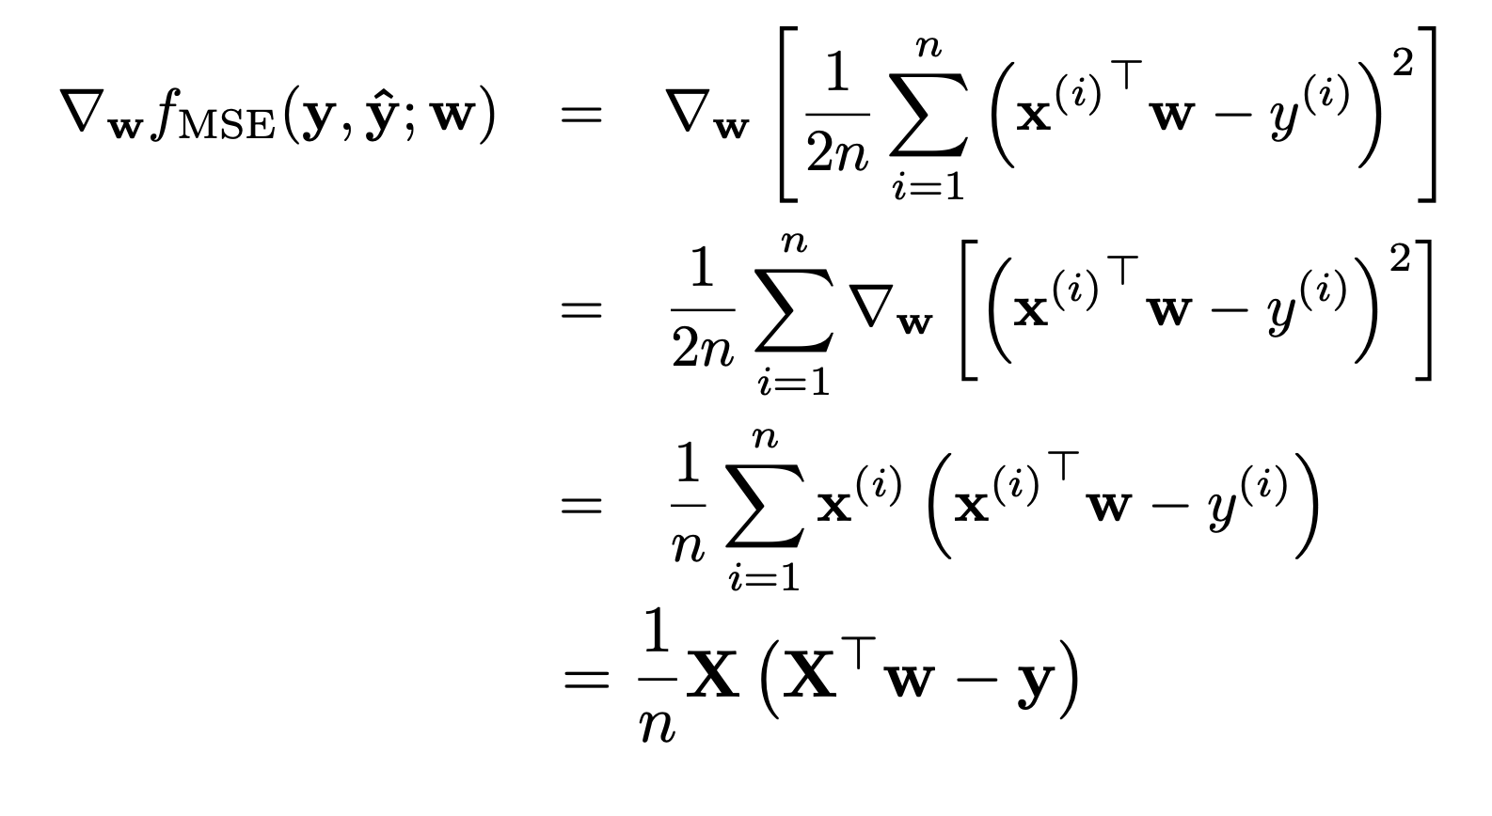
Gradient Descent
MSE case
10

Slide 22
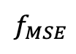

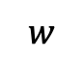
Gradient Descent
Gradient descent is a hill-climbing algorithm that
makes incremental changes to weight vector w
depending on the value of slope (i.e., gradient)
$$f_{MSE}$$
f
$$w$$
10

Slide 23
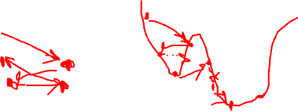
Gradient Descent
Gradient descent is a hill-climbing algorithm that
makes incremental changes to weight vector w
depending on the value of slope (i.e., gradient)
$$f_{MSE}$$
f
$$w$$
10

Slide 24
Gradient Descent
Gradient descent is a hill-climbing algorithm that
makes incremental changes to weight vector w
depending on the value of slope (i.e., gradient)
$$f_{MSE}$$
f
$$w$$
10

Slide 25
Gradient Descent. Algorithm
Randomly initialize weights w. This is our initial
weight vector w⁽⁰⁾
10

Slide 26

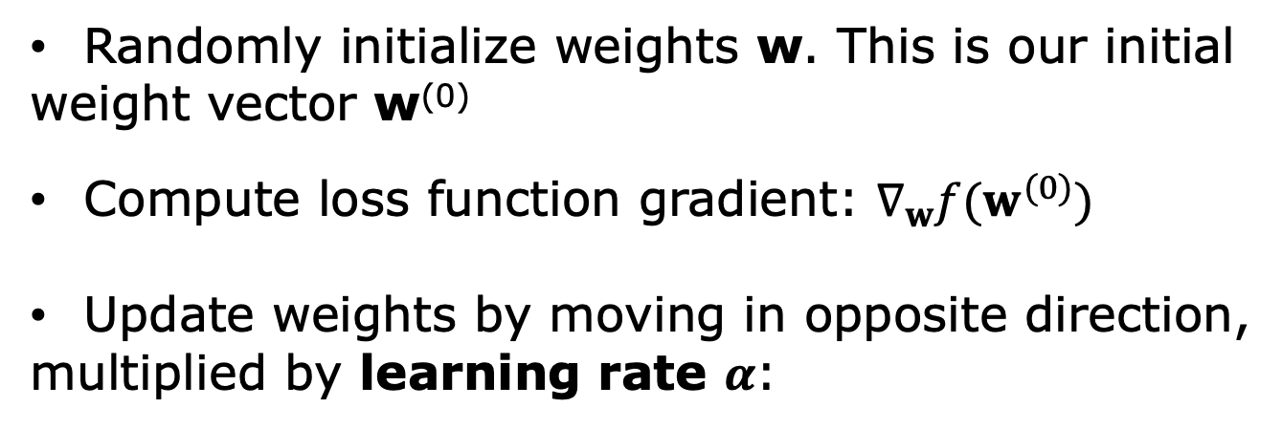
Gradient Descent. Algorithm
Randomly initialize weights w. This is our initial
weight vector w⁽⁰⁾
Compute loss function gradient: $∇_{w}f(w^{(0)})$
Update weights by moving in opposite direction,
multiplied by learning rate $α$:
$$w^{(1)}←w^{(0)}−α∇_{w}f(w^{(0)})$$
10

Slide 27
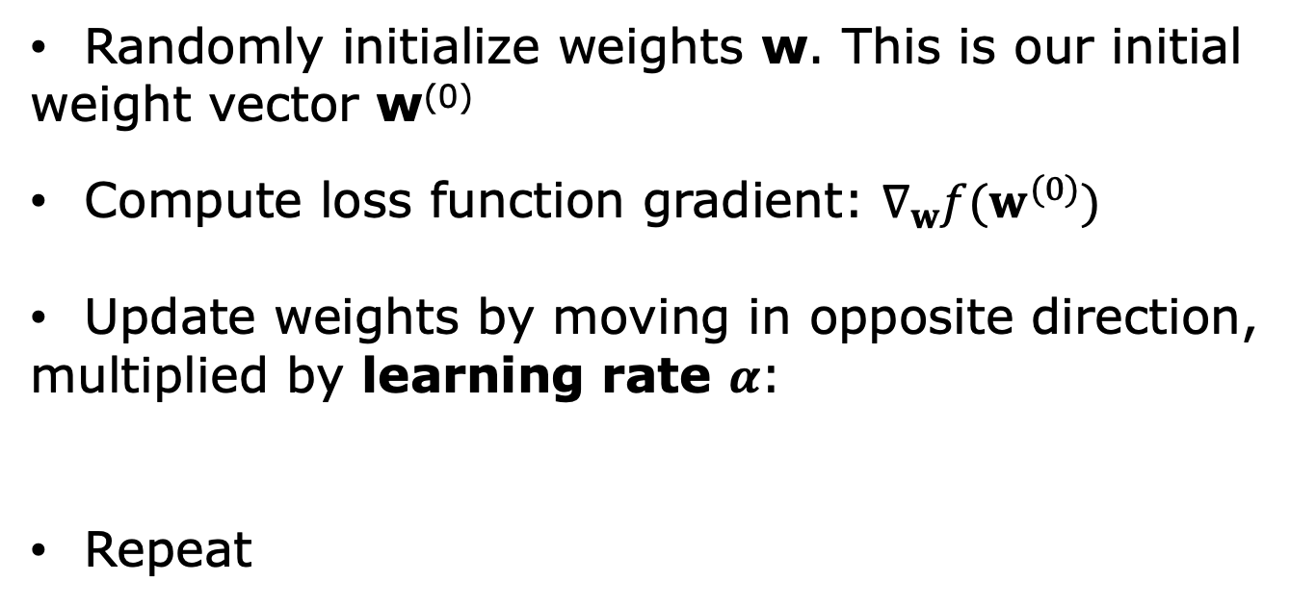

Gradient Descent. Algorithm
Randomly initialize weights w. This is our initial
weight vector w⁽⁰⁾
Compute loss function gradient: $∇_{w}f(w^{(0)})$
Update weights by moving in opposite direction,
multiplied by learning rate $α$:
Repeat
$$w^{(1)}←w^{(0)}−α∇_{w}f(w^{(0)})$$
$$w^{(i)}←w^{(i−1)}−α∇_{w}f(w^{(i−1)})$$
10

Slide 28
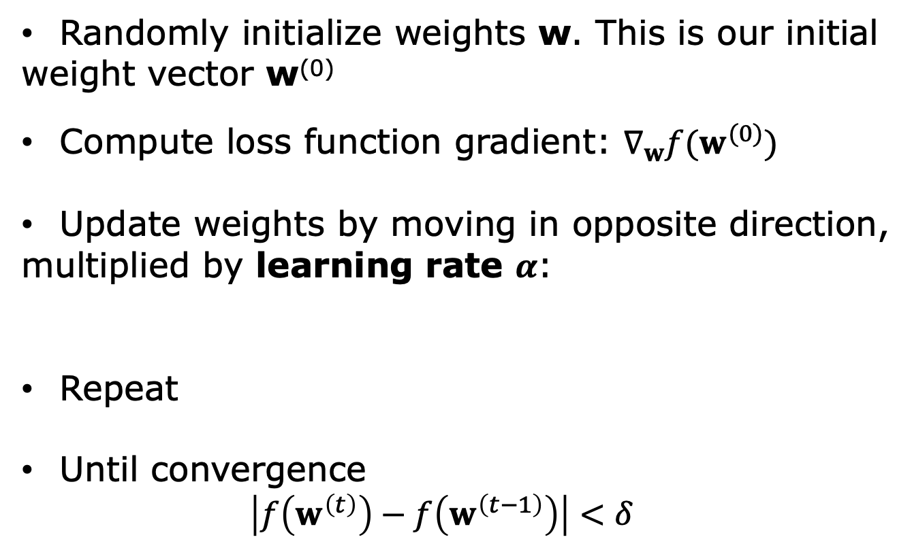
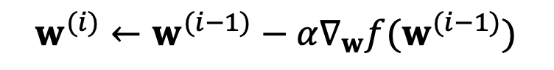
Gradient Descent. Algorithm
Randomly initialize weights w. This is our initial
weight vector w⁽⁰⁾
Compute loss function gradient: $∇_{w}f(w^{(0)})$
Update weights by moving in opposite direction,
multiplied by learning rate $α$:
Repeat
Until convergence
$$\left|f\left(w^{\left(t\right)}\right)−f\left(w^{\left(t−1\right)}\right)\right|<δ$$
$$w^{(1)}←w^{(0)}−α∇_{w}f(w^{(0)})$$
$$w^{(i)}←w^{(i−1)}−α∇_{w}f(w^{(i−1)})$$
10

Slide 29
Data Visualization

Slide 30
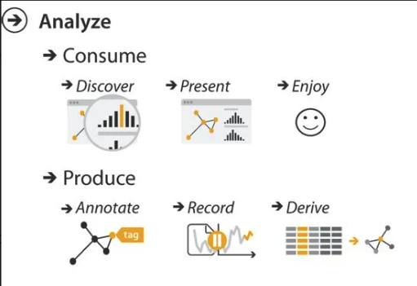
Why Visualization?

Slide 31
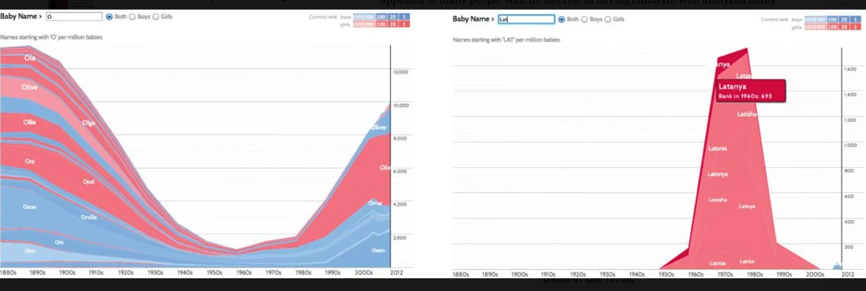
Example

Slide 32
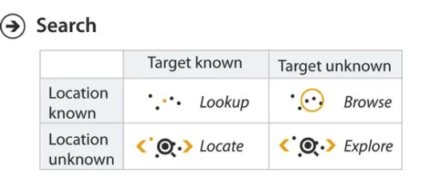
Why Visualization?

Slide 33
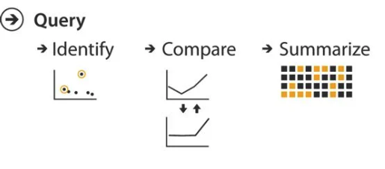
Why Visualization?

Slide 34
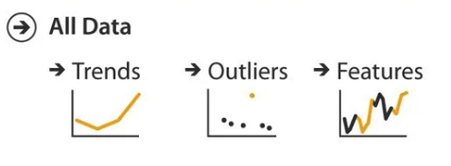
Why Visualization?

Slide 35
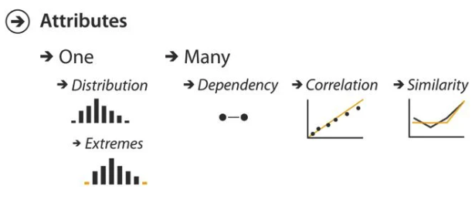
Why Visualization?

Slide 36
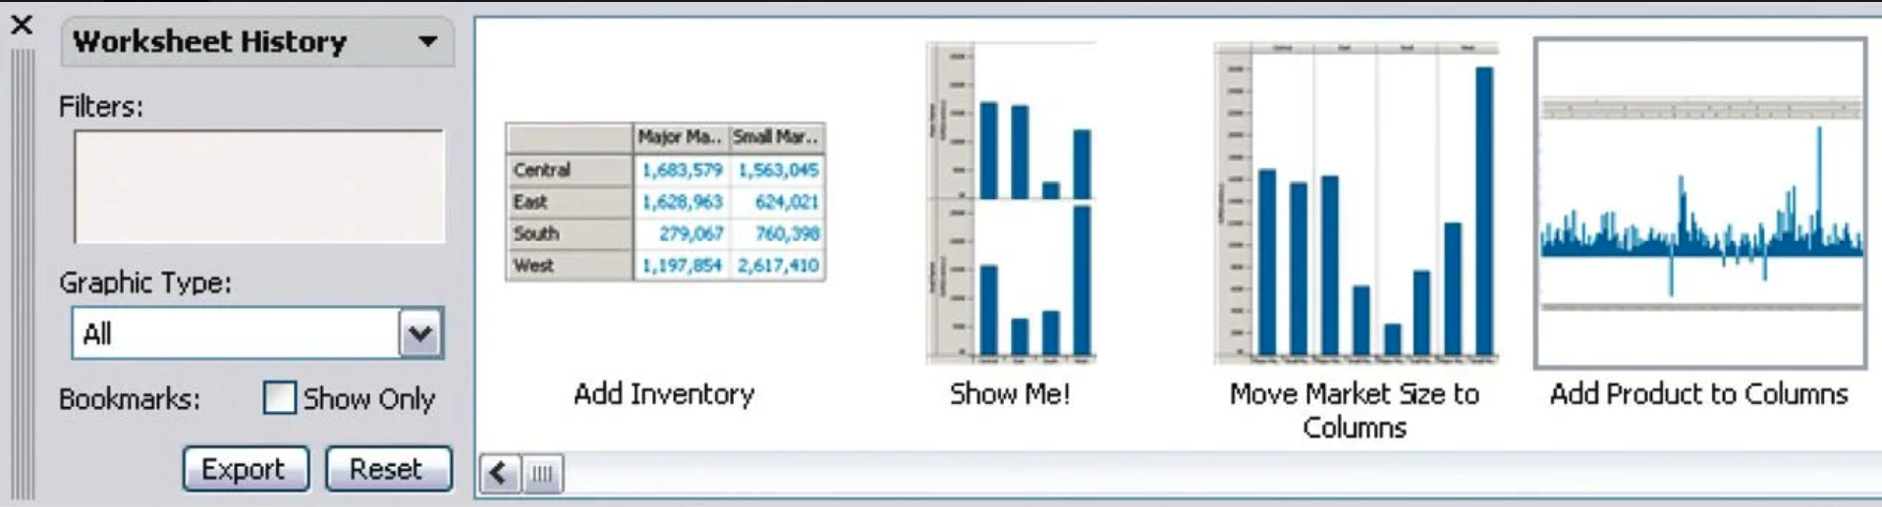
Example

Slide 37
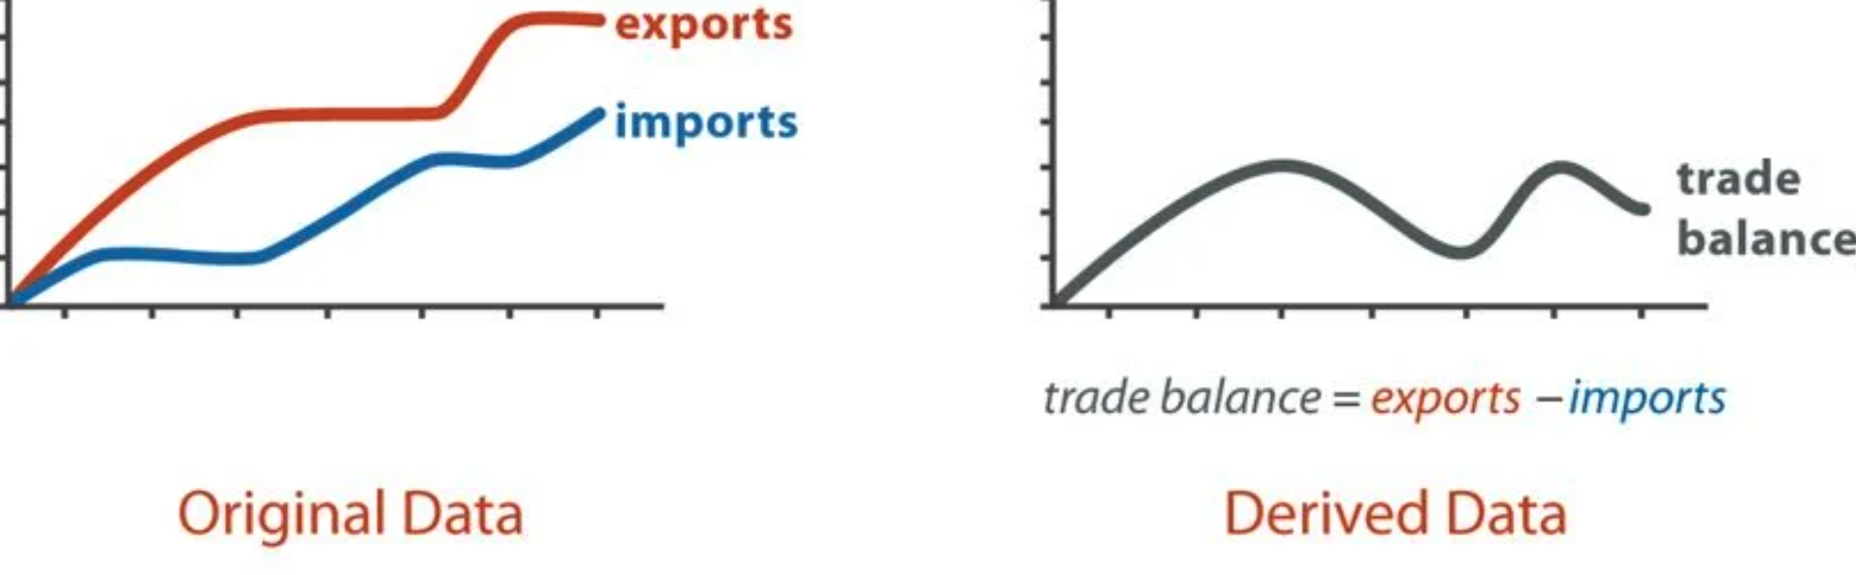
Example

Slide 38
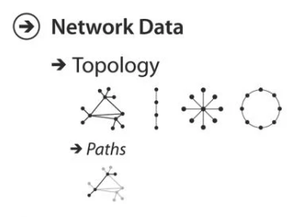
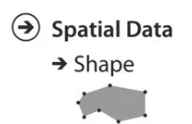
Why Visualization?

Slide 39
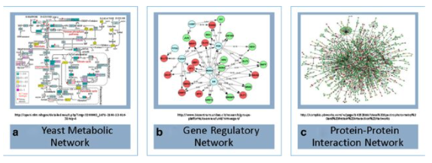
Example
Kim, Wooyoung, and Lynnette Haukap. "NemoProfile as an efficient approach to network motif analysis with instance collection." BMC bioinformatics 18 (2017): 37-45.

Slide 40
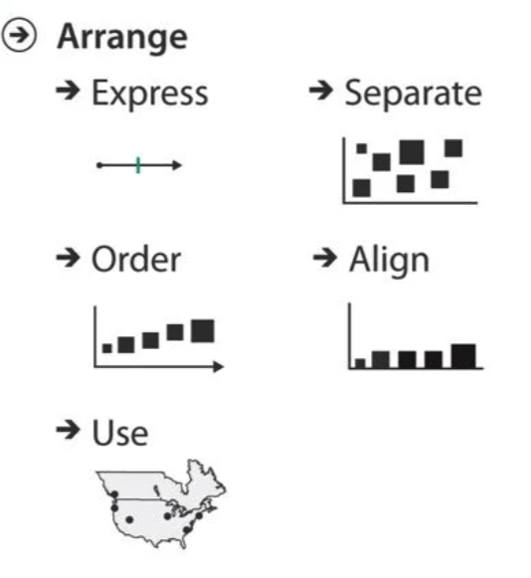
How to Visualize? Data Encoding

Slide 41
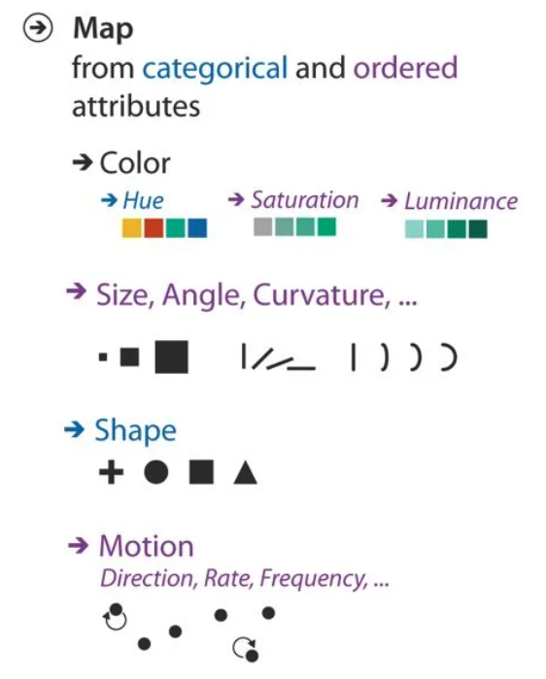
How to Visualize? Data Encoding

Slide 42
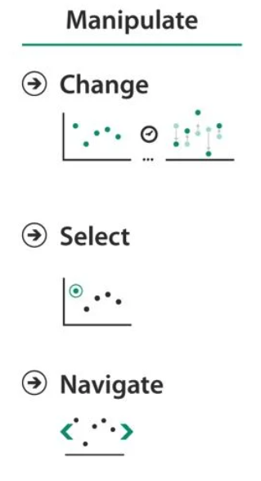
How to Visualize?

Slide 43
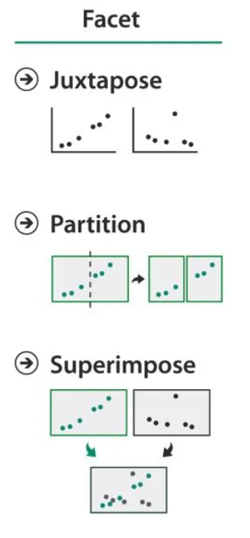
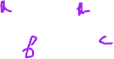
How to Visualize?

Slide 44
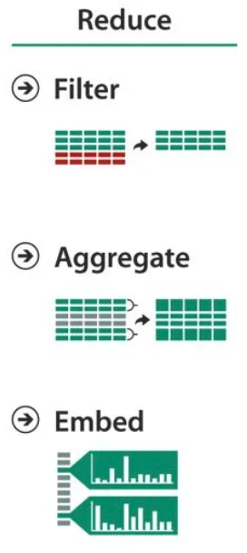
How to Visualize?

Slide 45
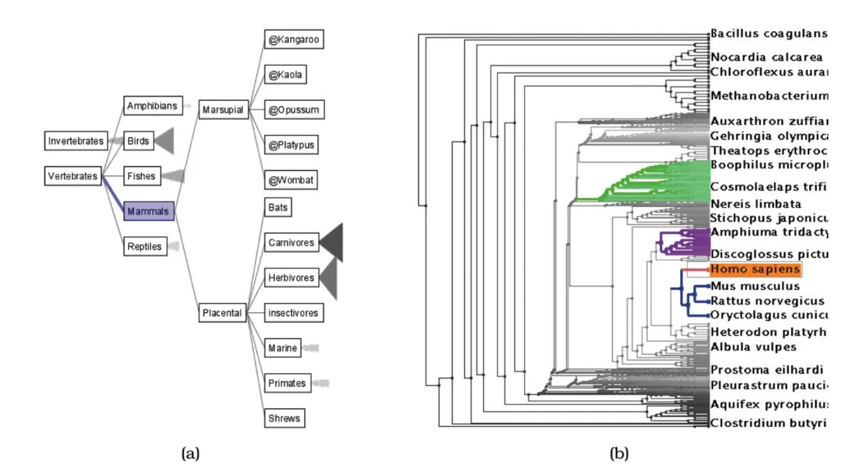
Examples
Space Tree
TreeJuxtaposer
From http://www.cs.umd.edu/hcil/spacetree and [Munzner et al. 03, Figure 1].

Slide 46
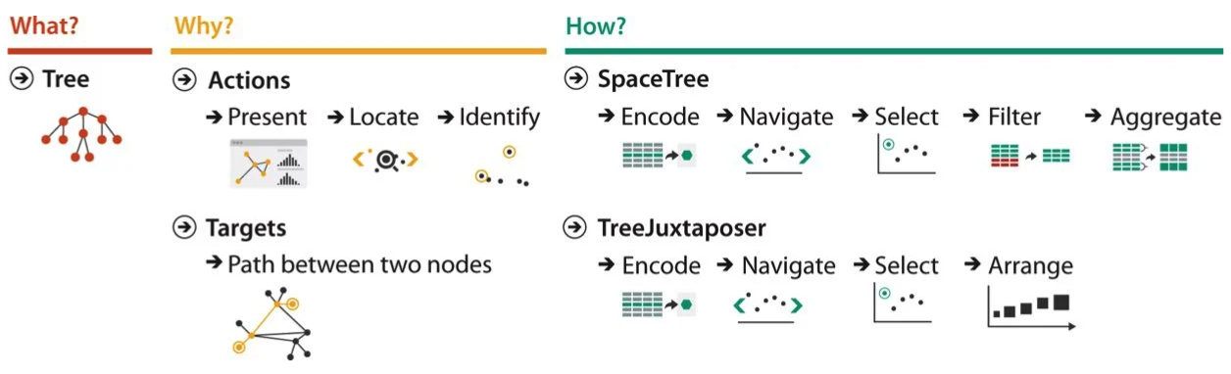
Examples

Slide 47
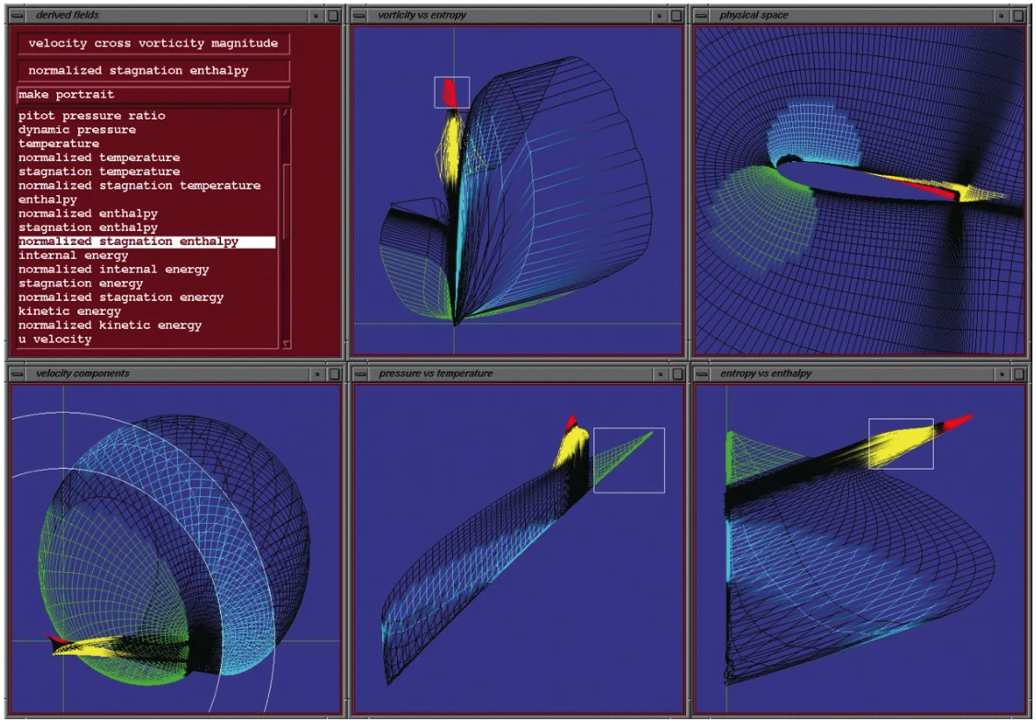
Examples
From [Henze 98, Figure 5].

Slide 48
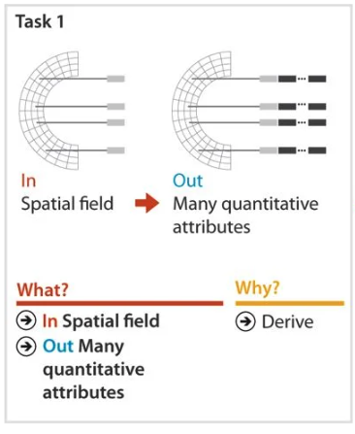
Examples

Slide 49
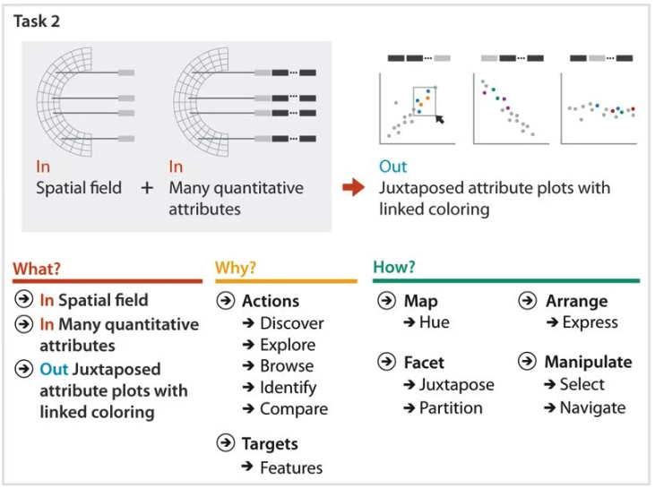
Examples

Slide 50
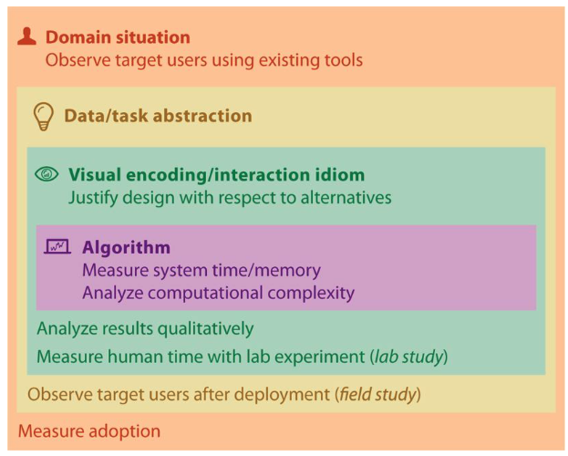
Validating Visualization

Slide 51
What Can Go Wrong?
• Wrong problem: You misunderstood their needs
• Wrong abstraction: You're showing them the wrong thing
• Wrong idiom: The way you show it doesn't work
• Wrong algorithm: Your code is too slow

Slide 52

How to Validate?

